Slide 1
Elements Of Lean Production Systems
By
Donald Paul
Ernst St. Louis and
Williams Charles
TEAM 4
1

Slide 2
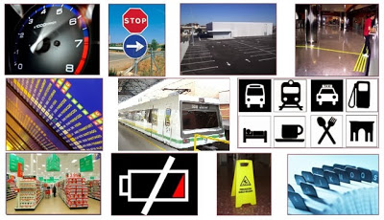
Visual Management
Notes:
Ejemplos de implementacion de proyectos 5 s 2 dias

Slide 3
Visual Managment
What it is? And why
It is important?
Visual management refers to the ability of an environment to make possible the interaction between people and information and their ability to decide and act alertly as a result of that interaction.

Slide 4
Controls or visual devices that allow anyone to recognize the standards and deviations from the standards.

Slide 5
Why it is important?
Create a standardized work environment.
Provide a visual state at a glance to recognize easily the standards and quickly detect abnormal conditions.
Easily expose performance and progress.
Alert to problems
A call for help
A plan for action

Slide 6
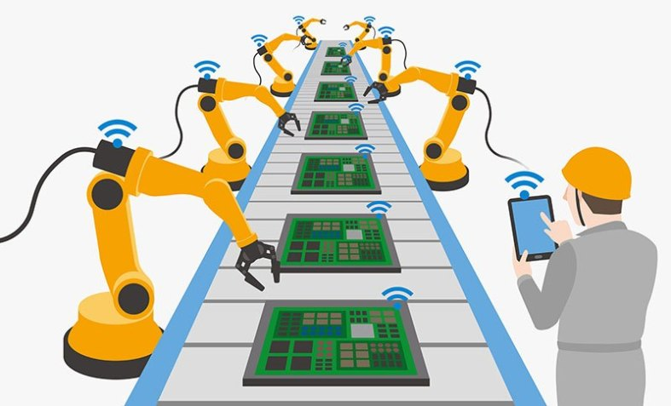
Automation (Jidoka)
The Japanese word ji-do-ka comprises three Chinese characters. The first, ji refers to the worker herself. If she feels “something is wrong” or “I am creating a defect,” she must stop the line. Do refers to motion or work, and ka to the suffix “-ation.” Taken together jidoka has been defined by Toyota as “automation with a human mind” and implies intelligent workers and machines identifying errors and taking quick countermeasures.

Slide 7
Automation (Jidoka)
Automation is the technology by which a process or procedure is performed with minimal human assistance.

Slide 8

Work Reduction
Also known as downsizing, Workforce reduction is reductions in force, reorganization, or restructuring. While workforce reduction typically involves permanent termination of employment, it can also involve other methods, including: Reducing the amount of work hours available for employees.

Slide 9
Work Reduction
Why do companies reduce workforce?
Downsizing can occur for many possible reasons: Corporate downsizing is often the result of poor economic conditions. Typically, the company has to cut jobs in order to lower costs or maintain profitability. ... Other times, a company downsizes when a product or service is cut, or the economy falters.

Slide 10
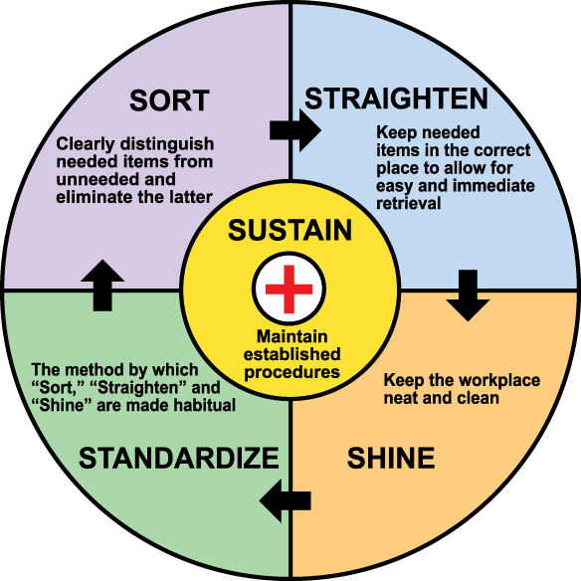
5S Principles
5-S is the key for Total Quality Environment.
The 5-S practice is a technique used to establish and maintain quality environment in an organization.

Slide 11
5S Principles
5S systems are common in manufacturing, warehouses, offices and hospitals but 5S principles can be applied to any workplace.
Pioneered by Toyota Motor Company, the 5S method applies standard housekeeping practices in the workplace through the five principles of Sort (seiri), Set in order (seiton), Shine (seiso), Standardize (seiketsu), and Sustain (shitsuke).

Slide 12
5S Principles
Notes:
Ejemplos de implementacion de proyectos 5 s 2 dias

Slide 13
Autonomous Maintenance
13

Slide 14
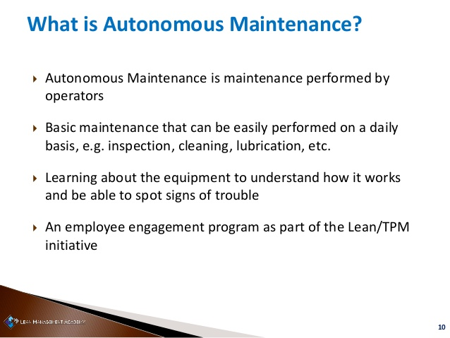
14

Slide 15
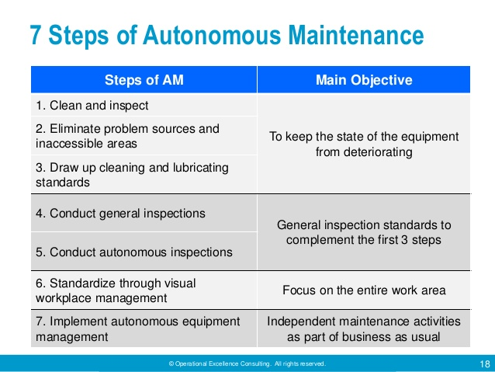
15

Slide 16
MAPS OF PROCESS OF OPERATIONS
16

Slide 17
What Should One Include in The Operations Management Process Map?
According to Mary Ann Anderson, Edward J. Anderson and Geoffrey Parker, in their book “Management For Dummies”, “a well-defined process have many special cases or deviations, so documenting or describing operations and business processes in a clear and practical way ensures that everyone involved — employees, managers, and stakeholders — can see how specific operations relate to others and what happens at each point in a process. Clear documentation can also help with employee training and performance assessments, operational analysis, and other business functions.
17

Slide 18
Operations managers usually use process maps (which are also called flow diagrams, flow maps, or flowcharts) to represent processes.”
The process is simple:
Inputs Outputs
Operations:
Flows
Delays
Raw material inventory (RMI)
Work in progress (WIP)
Finished goods inventory (FGI)
Resources
PROCESS
18

Slide 19
MEASUREMENT AND STUDIES OF WORK
19

Slide 20
According to Industrial Times study Institute Inc.
Work Measurement Study is a general term used to describe the systematic application of industrial engineering techniques to establish the work content and time it should take to complete a task or series of tasks.
Work measurement is a productivity improvement tool. Before improvements can be made, the current productivity level of an organization must be measured.
20

Slide 21
Measurement AND Studies of Work
This measurement is then used as a baseline to determine if improvement projects have resulted in genuine improvement.
Work measurement helps to uncover non-value added areas of waste, inconsistency, and non-standardization that exist in the workplace.
21

Slide 22
Measurement AND Studies of Work (Suite)
Work measurement studies uncover ways to make work easier, and to produce products or services more quickly and economically.
Work is measured for four reasons:
1-To discover and eliminate lost or ineffective time.
2- To establish standard times for performance measurement.
3- To measure performance against realistic expectations.
4- To set operating goals and objectives.
22

Slide 23
It also involves the use of engineered labor standards to measure and control the amount of time required to perform a specific task or tasks. While labor standards are most commonly associated with manufacturing or production environments, standards are used in many other types of settings including, but not limited to:
service or administrative,
warehousing and distribution,
retail,
janitorial,
medical and utilities.
23

